Slide 1
Disorder in Graphene:
Weak Localization

Slide 2
Introduction
How to prepare Graphene: CVD
Experiment: Visualizing Weak Localization

Slide 3
Background Knowledge and Introduction

Slide 4
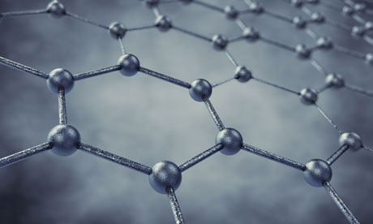
What is Graphene ?
Graphene is a two-dimensional material in which carbon atoms are arranged in a planar hexagonal lattice.
Graphene is an atomic scale material, so quantum mechanical effects are expected to be prominent. One such effect is “weak localization”.

Slide 5
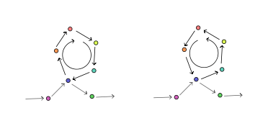
Weak Localization: Wave-particle duality
In Graphene, the wave property of electrons is noticeable in current-voltage characteristics.
When magnetic field is absent, due to constructive interference we expect increased possibility of electron at same point, which means lower current and higher resistance.
In presence of magnetic field, constructive interference is lost and resistance decreases.
"Weak localization scattering" by A13ean - Own work. Licensed under CC BY-SA 3.0 via Wikimedia Commons - http://commons.wikimedia.org/wiki/File:Weak_localization_scattering.svg#/media/File:Weak_localization_scattering.svg

Slide 6
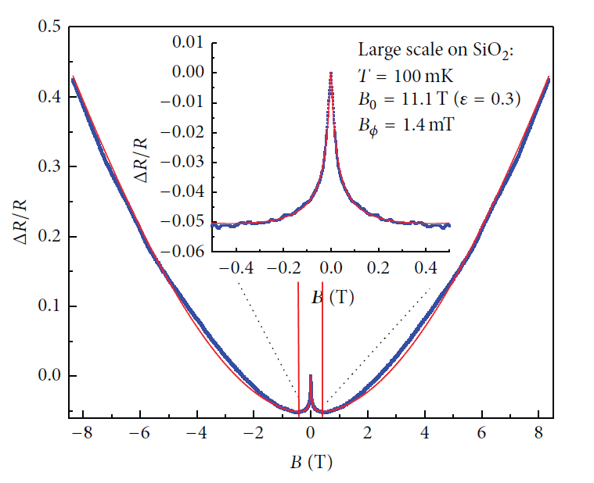
A closer look of weak localization
Hilke, Michael & Massicotte, Mathieu & Whiteway, Eric & Yu, Victor
TheScientificWorldJournal, 2014, 737296--737296 (2014)

Slide 7
How to prepare Graphene
The Development of Growing Graphene by CVD and Transferring method

Slide 8
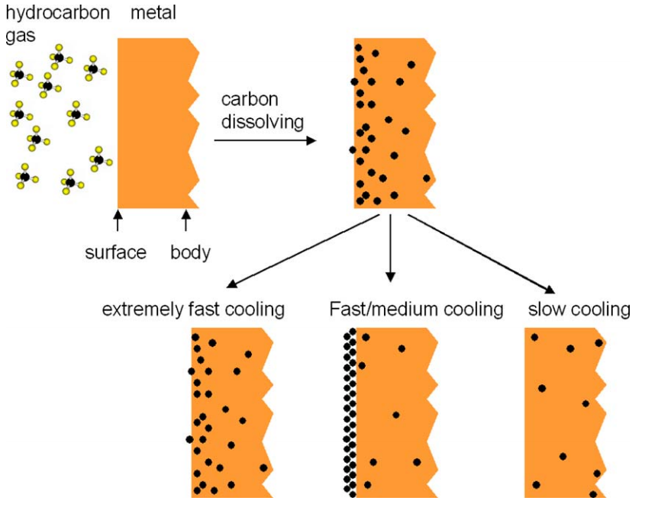
CVD: Chemical vapor deposition
In order to produce thin layer graphene, we need to expose metal film to hydrocarbon flow.
Yu, Q., Lian, J., Siriponglert, S., Li, H., Chen, Y. P., & Pei, S. S. (2008). Graphene segregated on Ni surfaces and transferred to insulators. Applied Physics Letters, 93(11), 113103.

Slide 9
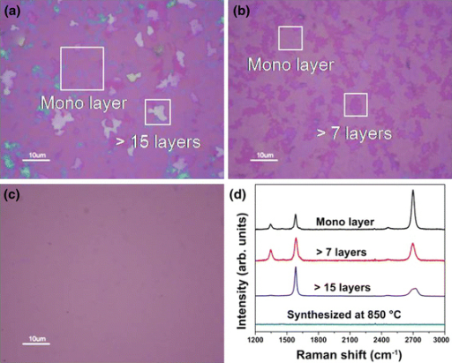
Further refinement of CVD
highly diluted hydrocarbon
Single-Crystalline Ni film
Thinner layer of metal material
Lee, Byeong-Joo, Han-Young Yu, and Goo-Hwan Jeong. "Controlled synthesis of monolayer graphene toward transparent flexible conductive film application."Nanoscale research letters 5.11 (2010): 1768-1773.

Slide 10
Experiment Process

Slide 11
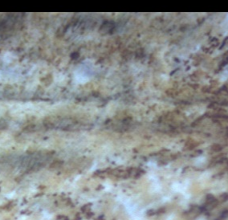
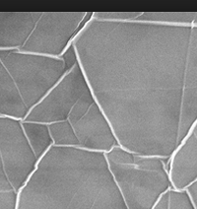
Before Transfer: Multi layer Graphene on Copper and Nickle
From Graphene supermarket

Slide 12
Transferring Process: Transfer Graphene On Copper to the substrate
1.wash sample with acetone
2.cover the sample with PMMA
3.heat the sample on metal
4.Desolve metal by acid
5.Transfer remaining PMMA to substrate
6.Heat
7.Remove PMMA by acetone

Slide 13
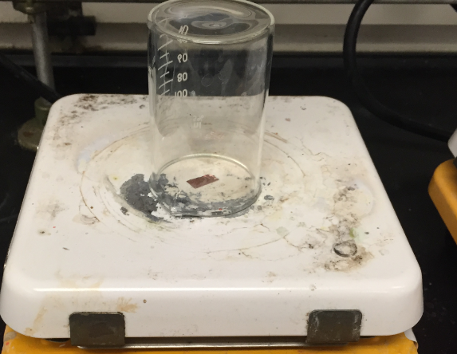

Slide 14
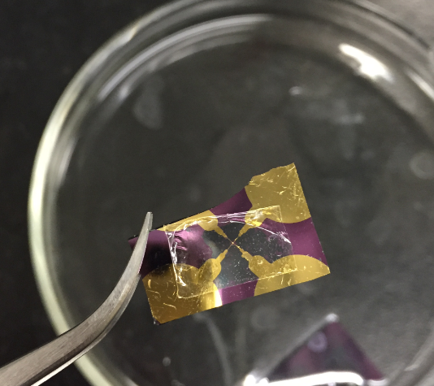

Slide 15
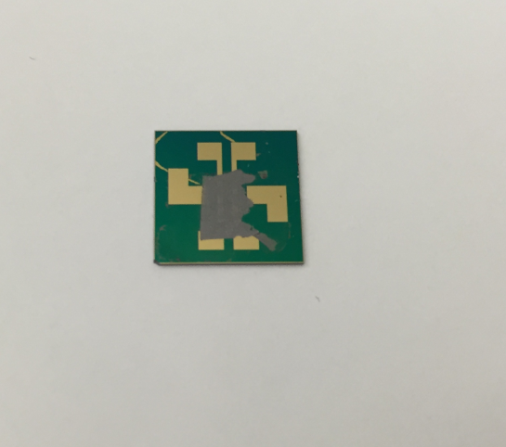

Slide 16
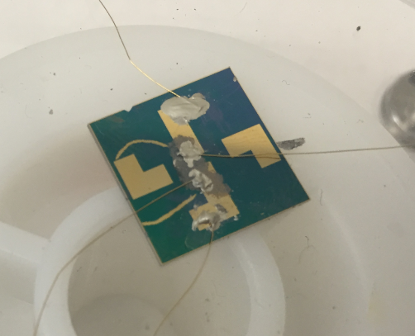

Slide 17
Results Representation

Slide 18
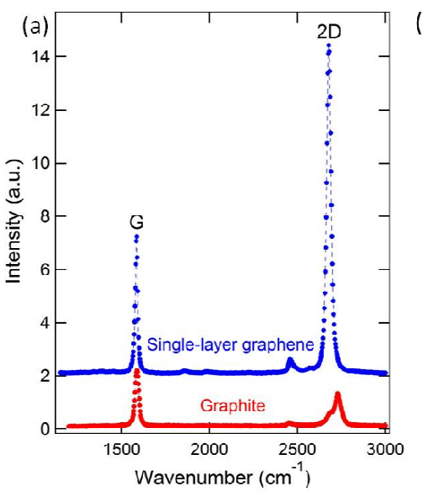
Raman Spectroscopy: Characteristic of Graphene
Childres, Isaac, et al. "Raman spectroscopy of graphene and related materials." Developments in photon and materials research (2013).

Slide 19
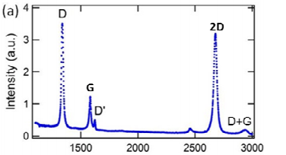
Raman Spectroscopy: Defects of Graphene
Childres, Isaac, et al. "Raman spectroscopy of graphene and related materials." Developments in photon and materials research (2013).

Slide 20
Raman Spectrum of Multilayer Graphene on cupper

Slide 21
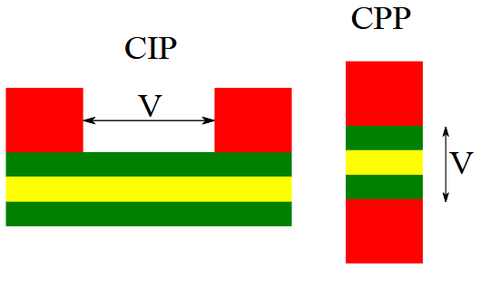
CIP and CPP
CIP: Current in Plane geometry
CPP: Current Perpendicular to plane configuration
"Spin-valve CIP CPP" by Alex-engraver - Own work. Licensed under CC BY-SA 3.0 via Wikimedia Commons-http://commons.wikimedia.org/wiki/File:Spin-valve_CIP_CPP.svg#/media/File:Spin-valve_CIP_CPP.svg

Slide 22
CIP Measurement

Slide 23
CPP Measurement

Slide 24
Test of circuit

Slide 25
Assumption about absence of weak localization
1. Sample is too thick (sample behave like graphite)
2. Too few defects (too uniform)

Slide 26
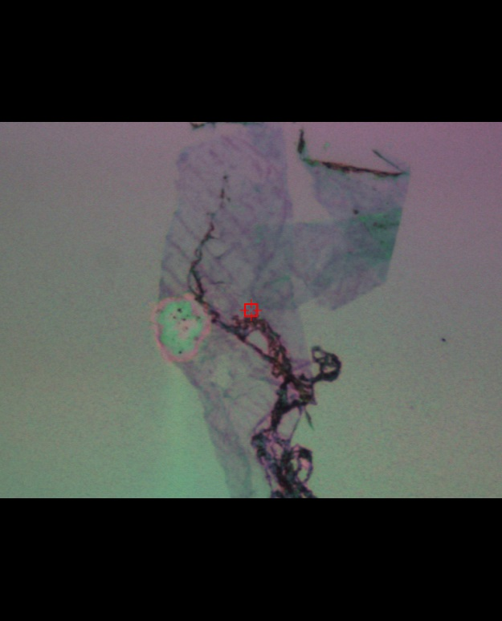

Slide 27
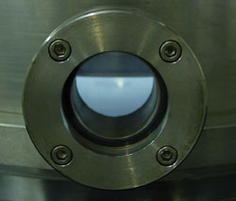
Creating more defects by hydrogen plasma
A new technic allows us to expand defects without etching graphene layers

Slide 28
Comparison of graphene sample before and after hydrogen plasma bombardment

Slide 29
CPP Measurement after defect creating

Slide 30
Test of circuit

Slide 31
Thanking
Dr. Sandipan Pramanik and Dr. Srikrishna Chanakya Bodepudi have given a lot of help in this research.
Thanks to their consistent and effective guidance, this research can finally flow smoothly and successfully.

Slide 32
Citation
R. V. Gorbachev, F. V. Tikhonenko, A. S. Mayorov, D. W. Horsell, and A. K. Savchenko, Phys. Rev. Lett. 98, 176805,2008,Apr 26
Datta, S. (1995). Electronic Transport in Mesoscopic Systems. Cambridge University Press.ISBN 0521599431.
A. H. Castro Neto, F. Guinea, N. M. R. Peres, K. S. Novoselov, and A. K. Geim, Rev. Mod. Phys. 81, 109 – Published 14 January 2009
Zhimin L, Hanchun W, Shishir K, Duesberg G S, Yangbo Z, Cross G L W, Shvets I V and Dapeng Y 2012 Adv. Mater. 24 1862

Slide 33
Citation
Yu, Q.; Lian, J.; Siriponglert, S.; Li, H.; Chen, Y. P.; Pei, S.-S. Applied Physics Letters 2008,93, 113103–113103–3.
Reina, A.; Jia, X.; Ho, J.; Nezich, D.; Son, H.; Bulovic, V.; Dresselhaus, M. S.; Kong, J.Nano Lett. 2008, 9, 30–35.
Kim, K. S.; Zhao, Y.; Jang, H.; Lee, S. Y.; Kim, J. M.; Kim, K. S.; Ahn, J.-H.; Kim, P.;Choi, J.-Y.; Hong, B. H. Nature 2009, 457, 706–710.
Zhang, Y.; Gomez, L.; Ishikawa, F. N.; Madaria, A.; Ryu, K.; Wang, C.; Badmaev, A.;Zhou, C. J. Phys. Chem. Lett. 2010, 1, 3101–3107.

Slide 34
Citation
Lee, Byeong-Joo, Han-Young Yu, and Goo-Hwan Jeong. "Controlled synthesis of monolayer graphene toward transparent flexible conductive film application." Nanoscale research letters 5.11 (2010): 1768-1773.
Hilke, Michael & Massicotte, Mathieu & Whiteway, Eric & Yu, Victor
TheScientificWorldJournal, 2014, 737296--737296 (2014)
Childres, Isaac, et al. "Raman spectroscopy of graphene and related materials." Developments in photon and materials research (2013).

Slide 35
A More Insight View
The weak localization effect manifests itself much stronger in low dimensional systems, since it is much more likely to find a self-crossing trajectory in low dimensions.[2]
Resistance is related to the probability of electron flowing from A to B.
As the result of trajectory interference, the probability that the electron goes back to the origin is enhanced, so the conductivity is reduced.[3]

Slide 36
Grow "Graphene" on Ni
It has been discovered that graphene segregation could be adopted to deliver high quality graphene with large area.
The grown graphene could be easily transferred by using nitric acid.
  This transferring process is fairly easy ,economical and highly feasible.

Slide 37
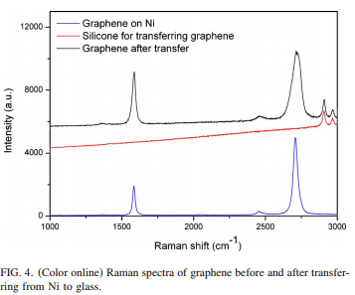
summary
Several layers of graphene had been synthesized on Ni substrates by a surface segregation process with controlled cooling and transferred to glass substrates.
TEM and Raman data showed that the graphene films can maintain their high quality even after being subject to the usage of HNO3 and various mechanical operations during the TEM sample preparation and substrate transfer.
Cooling rate found to be optimal and the quality of graphene films can be controlled by varying other growth conditions.
These results indicate that the surface segregation from metals in the ambient pressure with controlled cooling rates could offer a high quality and low cost synthesis approach for graphene as a practical electronic material.
Yu, Q.; Lian, J.; Siriponglert, S.; Li, H.; Chen, Y. P.; Pei, S.-S. Applied Physics Letters 2008,93, 113103–113103–3.

Slide 38
Fewer Layers, More Substrate !
The CVD process has been refined by exposing Ni film to highly diluted hydrocarbon flow, which gave ultra thin graphene.
  This improvement has enabled researchers more ability to control the layer of graphene.
Transferring process was also improved by the wet-etching of the underlying Ni film. It made transferring graphene to random substrate available.
  By introducing a PMMA layer, the graphene can almost be transferred to any material. Comparing to the original process, this improvement enabled more substrates choice.

Slide 39
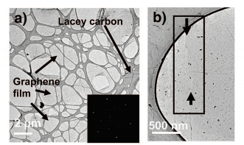
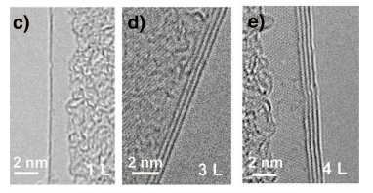
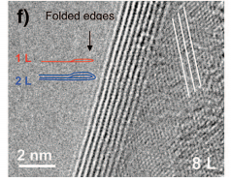
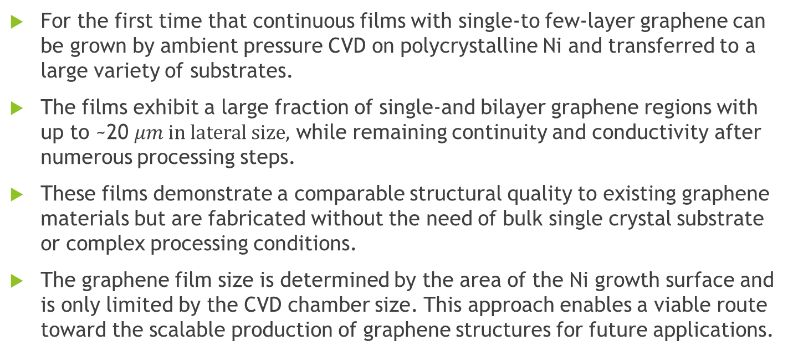
summary
For the first time that continuous films with single-to few-layer graphene can be grown by ambient pressure CVD on polycrystalline Ni and transferred to a large variety of substrates.
The films exhibit a large fraction of single-and bilayer graphene regions with up to ~20 $μm in lateral size,$ while remaining continuity and conductivity after numerous processing steps.
These films demonstrate a comparable structural quality to existing graphene materials but are fabricated without the need of bulk single crystal substrate or complex processing conditions.
The graphene film size is determined by the area of the Ni growth surface and is only limited by the CVD chamber size. This approach enables a viable route toward the scalable production of graphene structures for future applications.
Reina, A.; Jia, X.; Ho, J.; Nezich, D.; Son, H.; Bulovic, V.; Dresselhaus, M. S.; Kong, J.Nano Lett. 2008, 9, 30–35.

Slide 40
Stretchable !
Some researchers used a nickel film of thickness of 300 nm to grow graphene. It produced a more uniformed monolayer/bilayer graphene. It allowed property of graphene film unchanged after mechanical stretch.
  By this method, graphene can be made more uniformed. Hence stretchability of graphene is enhanced.
A new transferring method was also developed. Instead of using acid, they found Iron (III) chloride more attempting. It improvement prevent graphene from being damaged by bubbles produced by acid.
  Instead of using acid, Using Iron (III) chloride gives graphene better protection during transferring process.

Slide 41
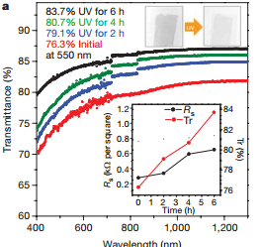
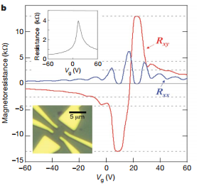
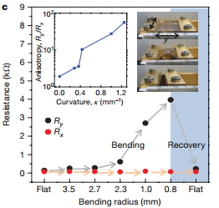
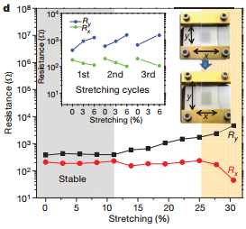
summary
A simple method had been developed to grow and transfer high-quality stretchable graphene films on a large scale using CVD on nickel layers.
The patterned films can easily be transferred to stretchable substrates by simple contact method, and the number of graphene layers can be controlled by varying the thickness of the catalytic metals, the growth time and and/or the ultraviolet treatment time.
The graphene films enable numerous applications including use in large-scale flexible, stretchable, foldable transparent electronics.”
Kim, K. S.; Zhao, Y.; Jang, H.; Lee, S. Y.; Kim, J. M.; Kim, K. S.; Ahn, J.-H.; Kim, P.;Choi, J.-Y.; Hong, B. H. Nature 2009, 457, 706–710.

Slide 42
Better Growth: Single-Crystalline Ni film
It was found that the formation for monolayer/bilayer graphene on the single crystal surface was much easier than that on polycrystalline Ni film. The secret was the nature of its smooth surface and absence of grain boundaries.
  Rather than using polycrystalline Ni film, single crystal Ni was adopted. It turned out that a smooth surface provides a better production of monolayer/bilayer graphene.

Slide 43
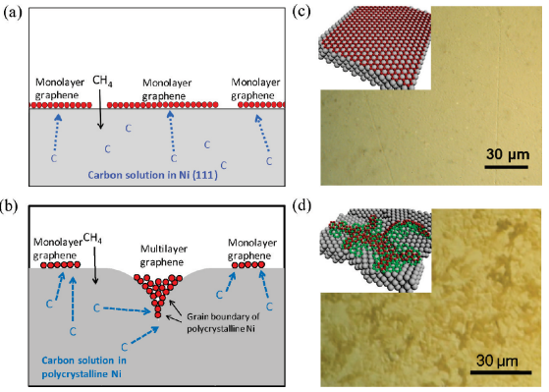

summary
Preferential formation of monolayer/bilayer graphene on the single crystal surface is attributed to its atomically smooth surface and the absence of grain boundaries. In contrast, CVD graphene formed on polycrystalline Ni leads to higher percentage of multilayer graphene ($≥$3 layers), which is attributed to the presence of grain boundaries in Ni that can serve as nucleation sites for multilayer growth.
Zhang, Y.; Gomez, L.; Ishikawa, F. N.; Madaria, A.; Ryu, K.; Wang, C.; Badmaev, A.;Zhou, C. J. Phys. Chem. Lett. 2010, 1, 3101–3107.

